Slide 1

Return to
Abstraction

Slide 2
ART HISTORY (SO FAR)
Today
35,000 years ago
-20k
-16k
-4.5k
-2.5k
-1k
Return to
Abstraction
Notes:
So, we just saw how as long as humans have been making art, very little of the time was spent on Realism. Another surprising thing is there is a little sliver of abstraction at the end of the timeline when artists return to abstraction with a vengeance.

Slide 3
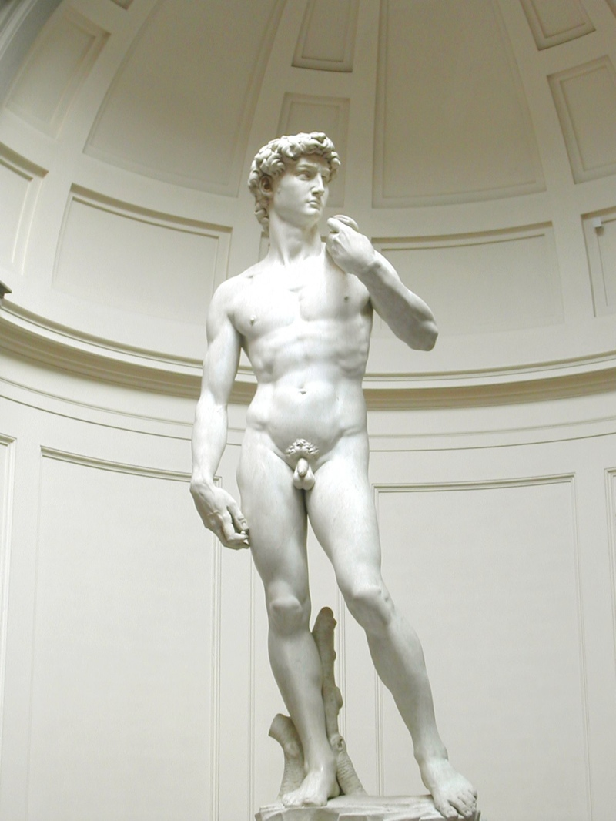
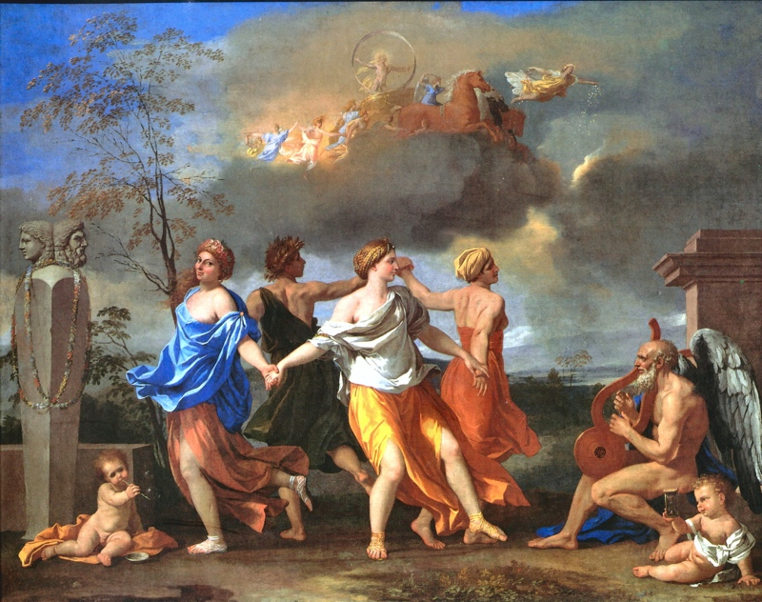
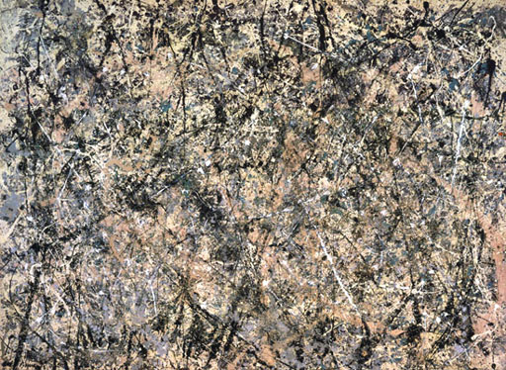
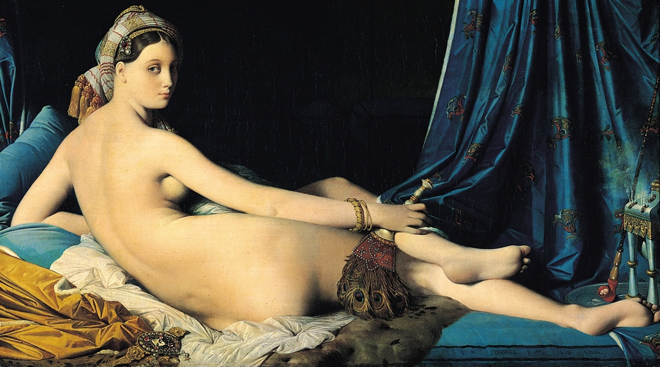
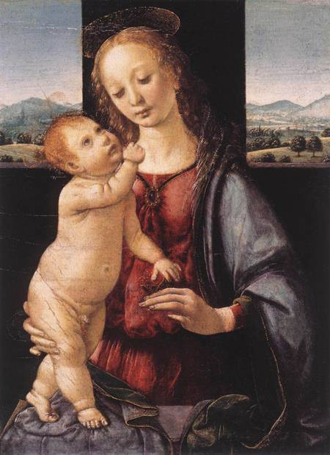
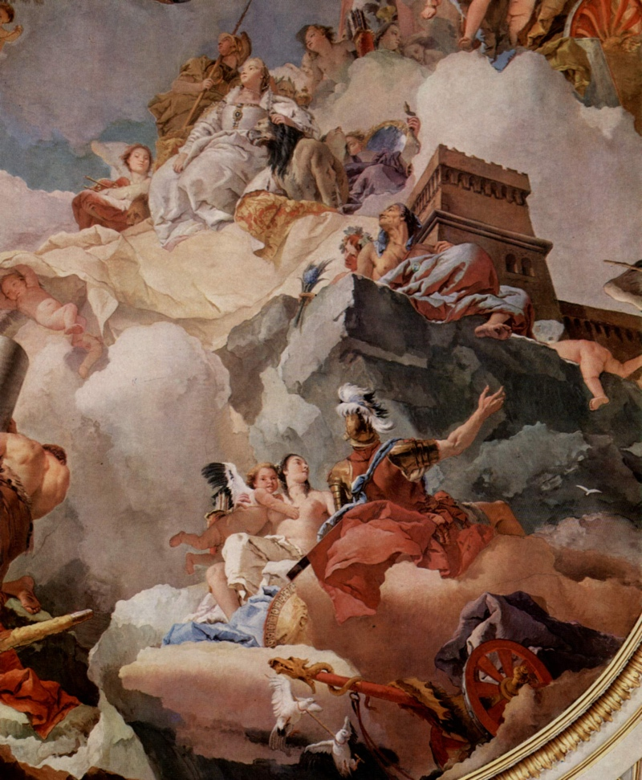
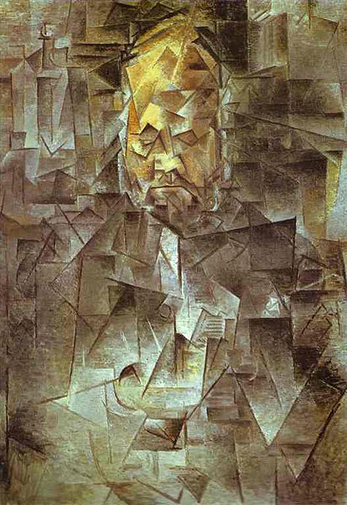
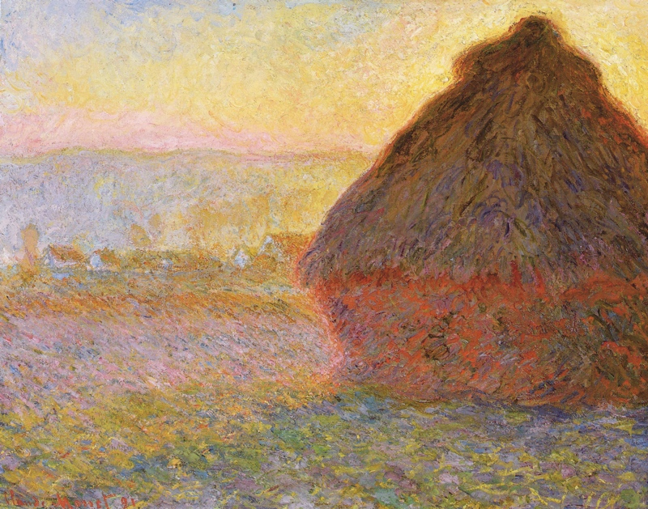
1500
1600
1700
1800
1900
2000
Notes:
So why do we have this return to abstraction?

Slide 4
1500
1600
1700
1800
1900
2000
Notes:
Now I don't want to say there's just one answer to this question, but a big part of the answer at least can be traced to an artistic crisis that happens between 19th and 20th centuries.

Slide 5
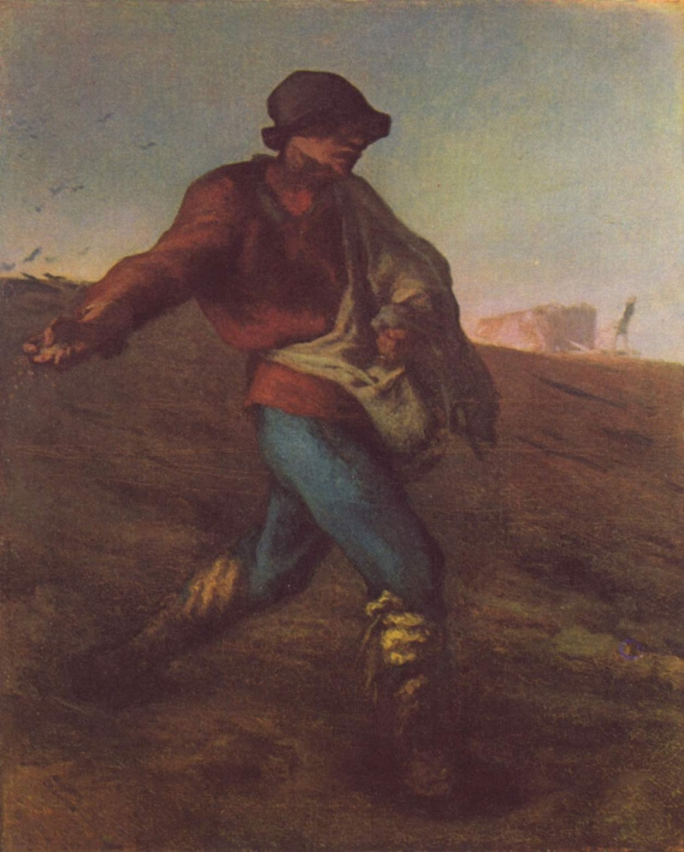
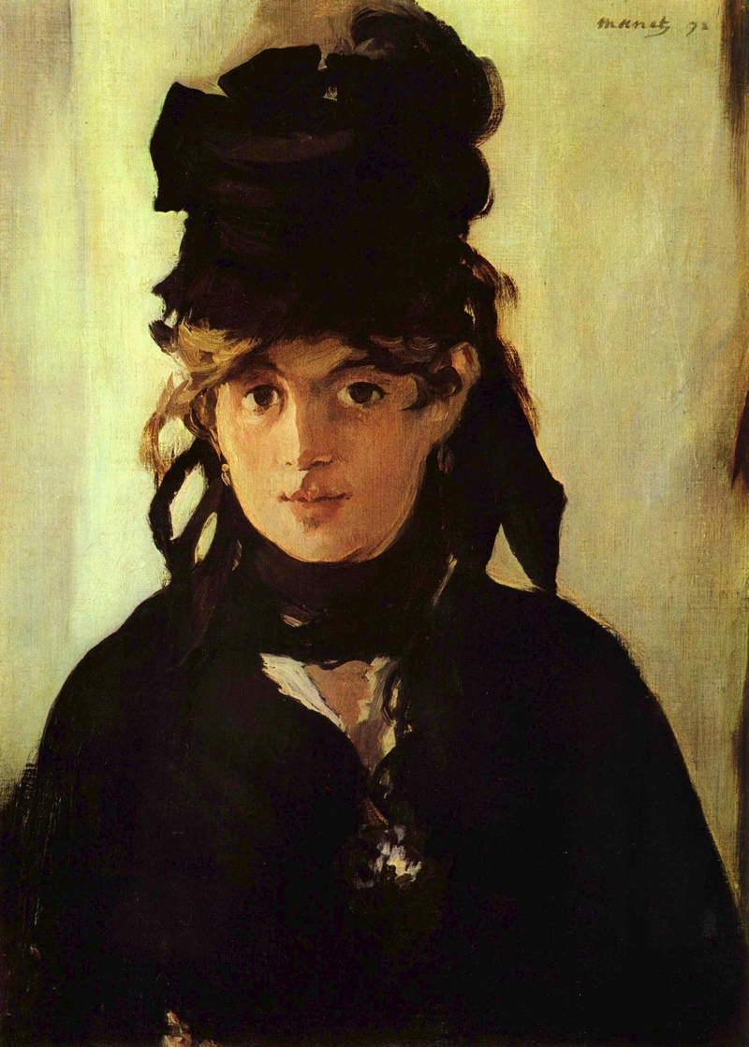
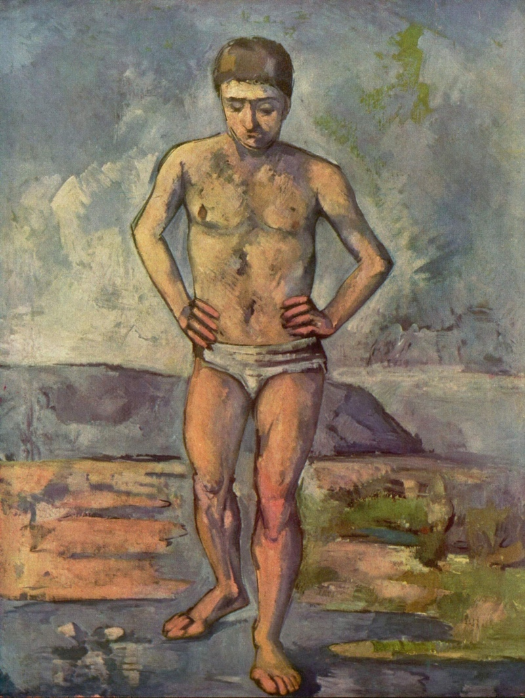
1800
1900
1814
1825
1850
1875
1885
1890
Notes:
Do you have an idea what could have brought about this crisis? What happens there on that tick mark at 1825?

Slide 6
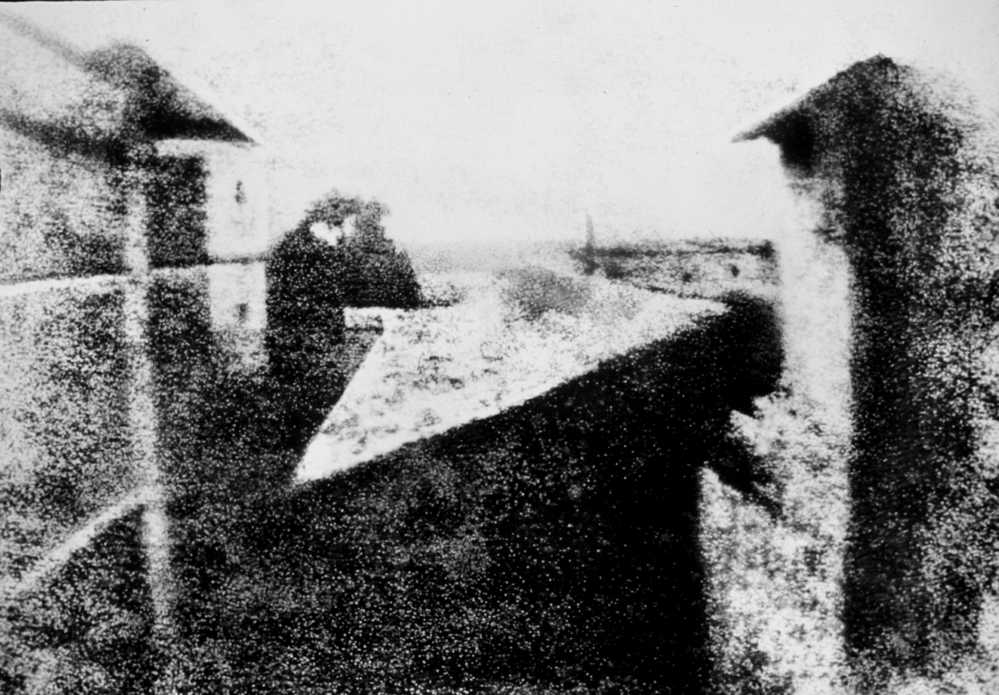
1826
Notes:
At this time we find the very first photographs, and while they were at first too blurry or took too long to develop, very quickly photographs became cheaper, faster, and more realistic than paintings.

Slide 7
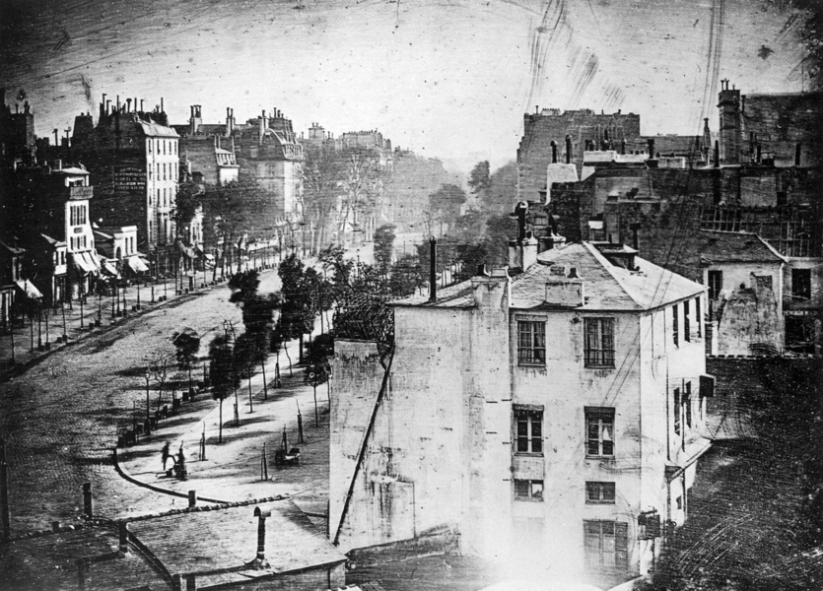
1838

Slide 8
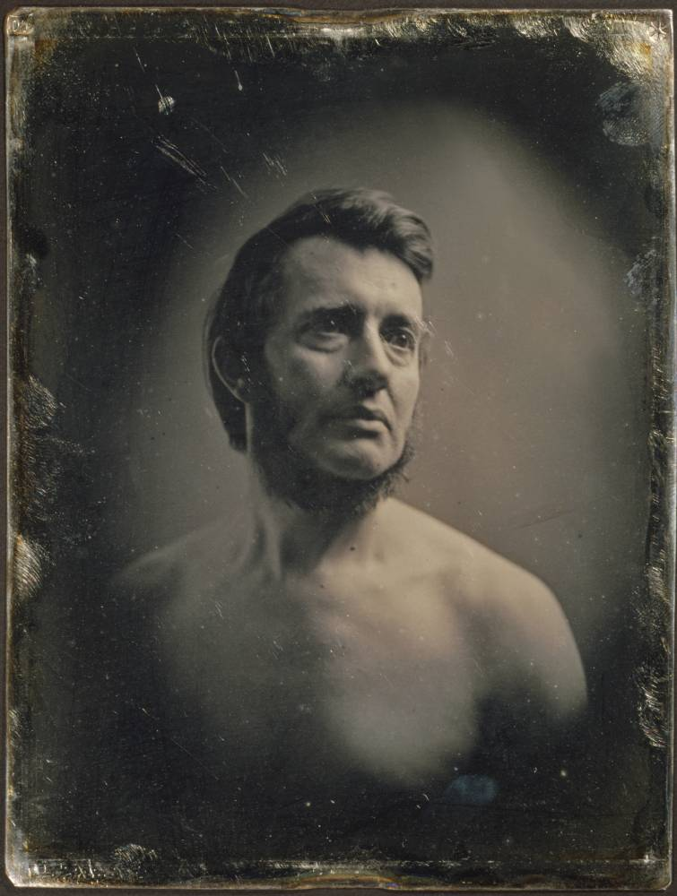
1848

Slide 9
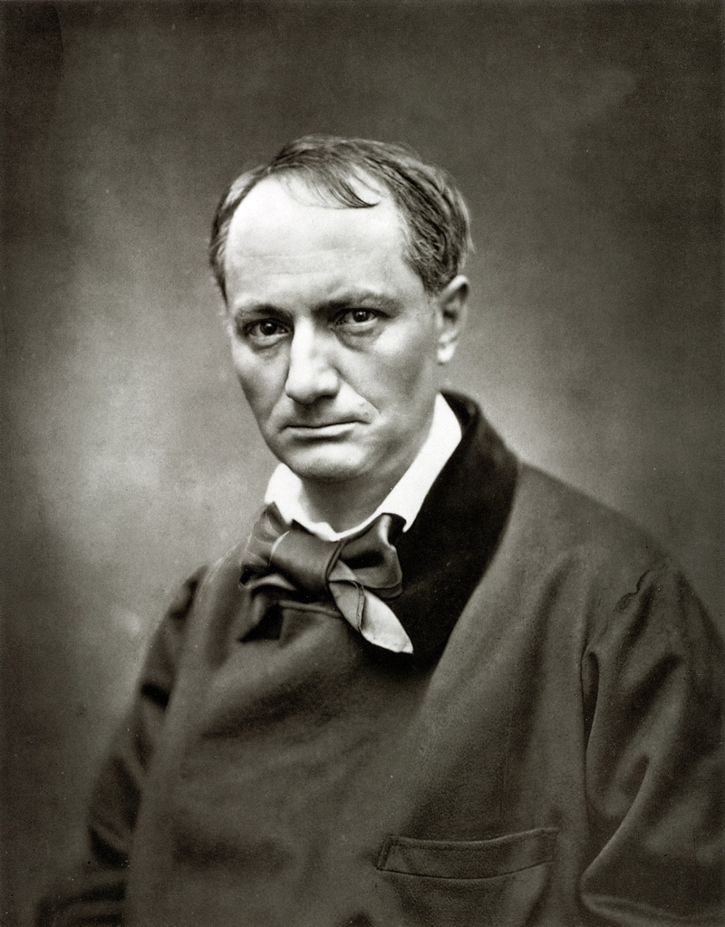
1863
Notes:
As soon as photography was able to capture the likeness of human beings, artists were thrown into a crisis because they have to prove to the world that they still had a unique and necessary talent.

Slide 10
1891
Notes:
And the one thing that painting still had going for it was color. So this is one reason why artists stopped paying attention to making extremely realistic paintings and instead started to focus on style and color.

Slide 11
Images:
paintings:
Poussin, The Dance to The Music of Time, 1640, French
Tiepolo, Apotheosis of Spain, 1762-66, Italian (work is in Spain)
Ingres, La Grande Odalisque, 1814, French
Millet, The Sower, 1850,
Manet, Berthe Morisot, 1872
Cezanne, The Bather, 1885
Monet, Haystacks, 1891, French
photography:
Joseph Nicéphore Niépce, View from the Window at Le Gras, 1825
Jacque Daguerre, Boulevard du Temple, 1838
Albert Southworth, Male Portrait,1848
Étienne Carjat, Charles Baudelair, 1863
Notes:
paintings:Poussin, The Dance to The Music of Time, 1640, FrenchTiepolo, Apotheosis of Spain, 1762-66, Italian (work is in Spain)Ingres, La Grande Odalisque, 1814, FrenchMillet, The Sower, 1850,Manet, Berthe Morisot, 1872Cezanne, The Bather, 1885Monet, Haystacks, 1891, Frenchphotography:Joseph Nicéphore Niépce, View from the Window at Le Gras, 1825Jacque Daguerre, Boulevard du Temple, 1838Albert Southworth, Male Portrait,1848Étienne Carjat, Charles Baudelair, 1863

